Slide 1

Programación concurrente y distribuida
Leonardo Camargo Forero, M.Sc
Sesión VI

Slide 2
Contacto
Leonardo Camargo Forero, M.Sc
Asistente de investigación - Computación Científica, Centro de Bioinformática y Biología Computacional. Ecoparque los Yarumos - Ed. BIOS
leonardo.camargo@ucaldas.edu.co

Slide 3
Agenda
Computación en Cluster
Definición
Tipos de cluster
Funcionamiento general
Capas de la arquitectura general
Algunos Benchmarks
Paralelización
Preguntas

Slide 4

http://www.olcf.ornl.gov/titan/
Cluster Computing

Slide 5
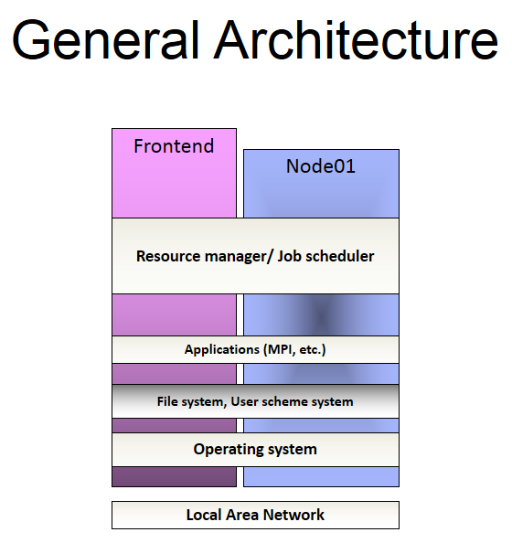

Slide 6



General behavior
Resource manager / Job scheduling
Compute nodes
Master
Jobs
Sequential
MPI
GPGPU …

Slide 7
Resource manager
Software in charge of the administration of available resources in a distributed platform. In cluster computing, the resources can represent hardware (Nodes, CPUs, GPUs, network interfaces) or software (Applications, licenses).
Job Scheduler
Software in charge of resource allocation for jobs. Implements a set of policies to describe a prioritization scheme in a multijob execution environment.

Slide 8
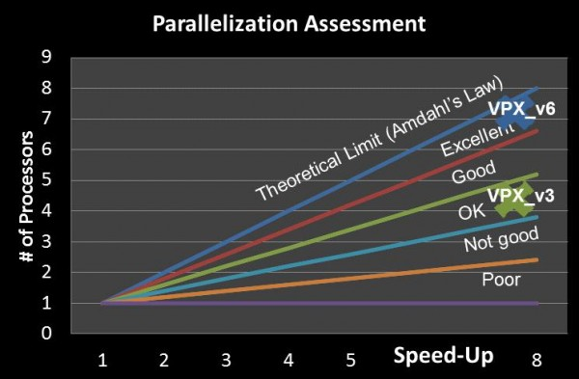
Parallelization

Slide 9
Paralellization (Master/Slaves)
Main subtask
Tasks
Subtask
Subtask
Subtask
Subtask

Slide 10
Paralelización
Task
Node, Process, master thread, ID = 0
Main subtask
Main subtask
Subtask
Subtask
Distribución de datos
Subtask
Subtask
Subtask
Subtask
Subtask
Subtask
Nodes, Processes, slave threads ID = {1,2,….n}
Number of subtasks is application-dependent

Slide 11
Parallelization
Node, Process, master thread, ID = 0
Nodes, Processes, slave threads ID = {1,2,….n}
Main subtask
Subtask
Subtask
Subtask
Subtask
Data distribution
<Data synchronization>
Node, Process, master thread, ID = 0
Subtask
Subtask
Subtask
Subtask
Main subtask
Nodes, Processes, slave threads ID = {1,2,….n}
Task

Slide 12

http://www.webopedia.com/imagesvr_ce/4818/network_large.jpg
Message Passing Interface

Slide 13
Features
Message passing standard (Industry standard, not IEEE or ISO), specification
Over 40 participants (organizations, vendors, researchers, etc.)
Cluster Computing
MIMD
Explicit parallelism
Portability

Slide 14
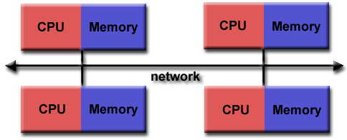
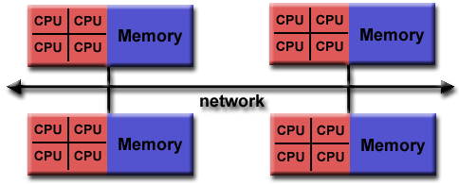
Memory model
https://computing.llnl.gov/tutorials/mpi/images/distributed_mem.gif
https://computing.llnl.gov/tutorials/mpi/images/hybrid_mem.gif
Distributed memory
Distributed shared memory

Slide 15



Implementations
http://www.codeart.in/openmpi.png
http://www.ugr.es/~jfernand/iconos/lam-logo.jpg
http://blogs.cisco.com/wp-content/uploads/mpich2-logo.gif

Slide 16
Implementations
Open MPI is a thread-safe, open source MPI-2
Available for most Linux distributions
mpicc, mpirun (commands used in class)
www.open-mpi.org
http://www.codeart.in/openmpi.png

Slide 17
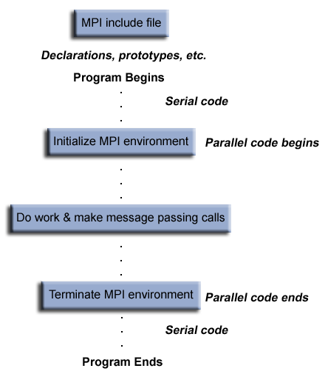
General MPI program structure
https://computing.llnl.gov/tutorials/mpi/images/prog_structure.gif

Slide 18
http://www.webopedia.com/imagesvr_ce/4818/network_large.jpg
C + MPI

Slide 19
C programming
Main Guidelines
Necessary library inclussion:
#include”mpi.h”
Instruction Format:
MPI_Xxxx_<xxx>
Success code: MPI_SUCCESS

Slide 20
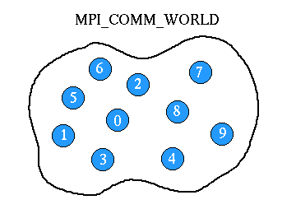
C programming
Main Guidelines
Communicators and groups: Collection of processes
Communicator by default: MPI_COMM_WORLD
http://einspem.upm.edu.my/INSPEM/MPI/knowing%20mpi/images/comm_world.gif

Slide 21
C programming
Main Guidelines
MPI routines have a communicator as an argument. i.e.
MPI_Comm_size(MPI_COMM_WORLD,&numTasks);
All processes have an ID (task ID or rank) [0,1,…,N]
The rank is very important in the definition of most MPI applications

Slide 22
http://www.webopedia.com/imagesvr_ce/4818/network_large.jpg
MPI Basic subroutines

Slide 23
MPI_Init
Function:
MPI environment initialization (required). Returns integer value i.e MPI_SUCCESS
Returned variable type
Integer
Use:
MPI_Init(&argc,&argv)
*argc: Arguments count
*argv: Arguments vector
Required for MPI applications

Slide 24
MPI_Comm_size
Function:
Returns number of tasks (Obtained by np mpirun flag)
Returned variable type
Integer
Use:
MPI_Comm_size(MPI_COMM_WORLD,&numTasks)

Slide 25
MPI_Comm_rank
Function
Returns Task id
Common scenario
Master process (id = 0)
Returned variable type
Integer
Use:
MPI_Comm_rank(MPI_COMM_WORLD,&taskID)

Slide 26
MPI_Abort
Function:
Safe termination. Thread cleaning
Use:
MPI_Abort(MPI_COMM_WORLD,errorcode)
*errorcode= integer

Slide 27
MPI_Get_processor_name
Function:
Returns processor hostname
Returned variable type
Char
Use:
MPI_Get_processor_name(hostname, &namelen);
*hostname = char
*namelen= integer (not initialized)

Slide 28
MPI_Finalize
Function:
Terminates MPI execution environment
Returned variable type
integer
Use:
MPI_Finalize()

Slide 29
http://www.webopedia.com/imagesvr_ce/4818/network_large.jpg
Exercise

Slide 30
Classwork 1
Estimate PI using MPI

Slide 31


